Slide 1
Final Year Project Design
DAIFAT MUSSA OTHMAN BITAM/9/21/026/TZ
AGRICULTURE MANAGEMENT SYSTEM
DR. HUSSEIN SHAABAN

Slide 2
Introduction

Slide 3
Feasibility Study Report Summary

Slide 4
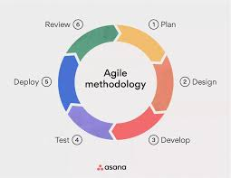
Methodology
Agile Methodology
Agile breaks down larger projects into small, manageable chunks called iterations. The highest priority is to satisfy customer, it easily adapt to changes.

Slide 5
Functional requirements

Slide 6
Non-functional requirement

Slide 7
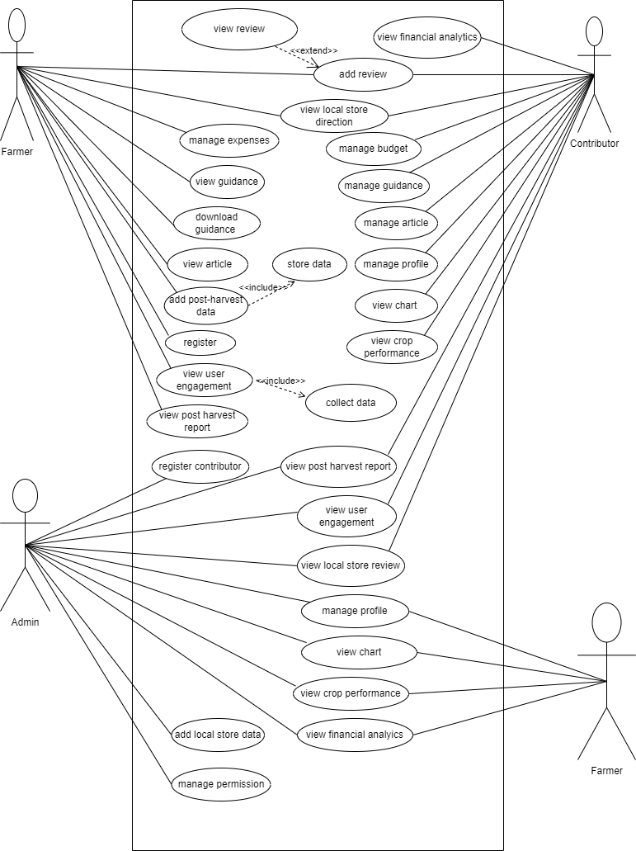
Requirement Modeling USE CASE

Slide 8
ERD

Slide 9
CLASS DIAGRAM

Slide 10
System architecture (Process Flow)

Slide 11
Database relational model

Slide 12
Design Demonstration

